Slide 1

Mobile and Simulation-based Approach to Reduce Dyslexia in Children with Learning Disabilities
24-25J-133

Slide 2





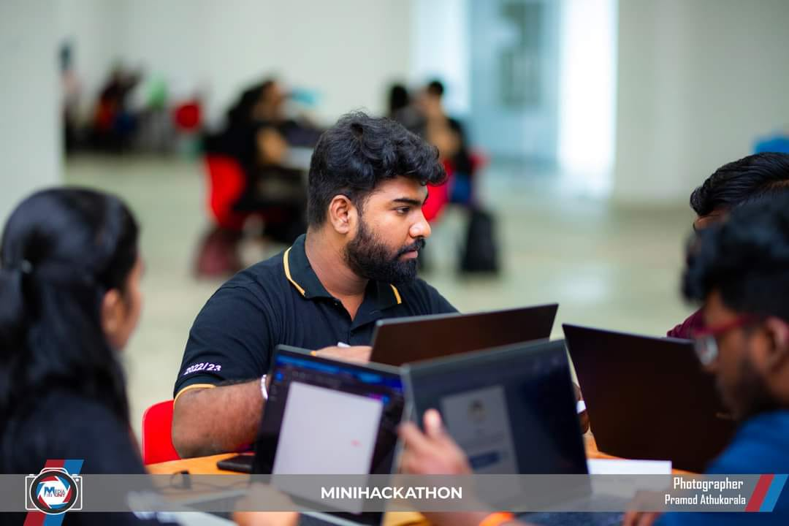
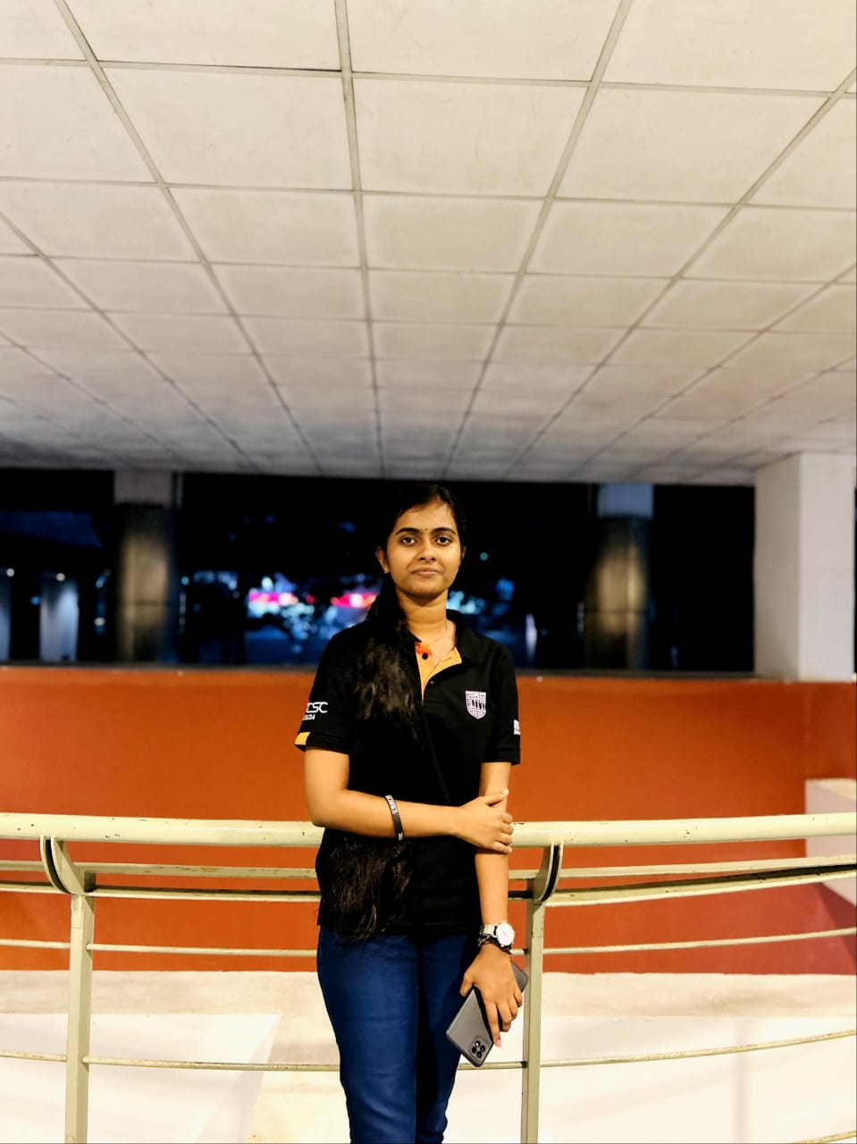
Members
Supervisor Dr. Kapila Dissanayaka
Co –supervisor Ms. Rivoni De Zoysa
External supervisor Dr. P. Gowritharan Speech and language Therapist & Counsellor Teaching Hospital- JAFFNA SLMC Reg : 113
Group Leader Shangeeth.V
Sanjeeva.N
Thiraviyarasa.A

Slide 3

Introduction to the overall project
1. What is dyslexia, and how does it affect children?
2. Why is there a need for a mobile application to support children with dyslexia?

Slide 4

Research Questions
How can a mobile application utilizing innovative solutions, such as Natural Language Processing (NLP) and machine learning, support children with dyslexia in improving their reading, processing, and memory skills?

Slide 5

Research Objectives
Main Objective To design and develop a mobile application that utilizes innovative solutions to support children with dyslexia in improving their reading, processing, and memory skills.

Slide 6
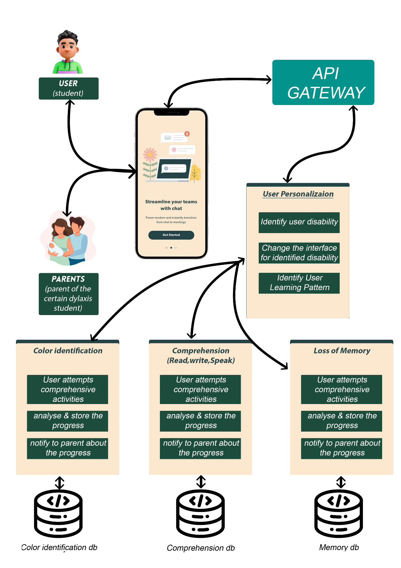
Overall solution as a system diagram

Slide 7

It21273858 |Shangeeth.V
SOFTWARE ENGINEERING
IT21273858 | Shangeeth.V | 24-25J-133

Slide 8

Component 01
Visual Processing Module
IT21273858 | Shangeeth.V | 24-25J-133

Slide 9

Introduction
Background
This Module is designed to support children with dyslexia who often struggle with visual perception and discrimination.
Research suggests that individuals with dyslexia may have underlying visual processing issues that impact their ability to learn.
Visual discrimination difficulties can impact students' performance in reading, writing, and mathematics.
By addressing these core visual processing challenges, the Visual Processing Improvement Module aims to enhance overall learning outcomes for children with dyslexia.
IT21273858 | Shangeeth.V | 24-25J-133

Slide 10
Research Problem
How can machine learning, Image processing algorithms be leveraged to dynamically adjust visual processing activities and games, improving visual skills of children with dyslexia?
IT21273858 | Shangeeth.V | 24-25J-133

Slide 11
Specific and Sub Objectives
Main Objective:
To design and develop a Visual Processing Module that improves the visualizing abilities of students with visual processing difficulties, including those with dyslexia.
Sub-Objectives:
Improve Visual Comprehension.
Enhance the capacity to distinguish between subtle differences in visual stimuli.
Enhance the ability to perceive complete forms from incomplete information.
Enhance the ability to understand the position of objects in relation to each other.
Develop handwriting fluency and accuracy.
IT21273858 | Shangeeth.V | 24-25J-133

Slide 12
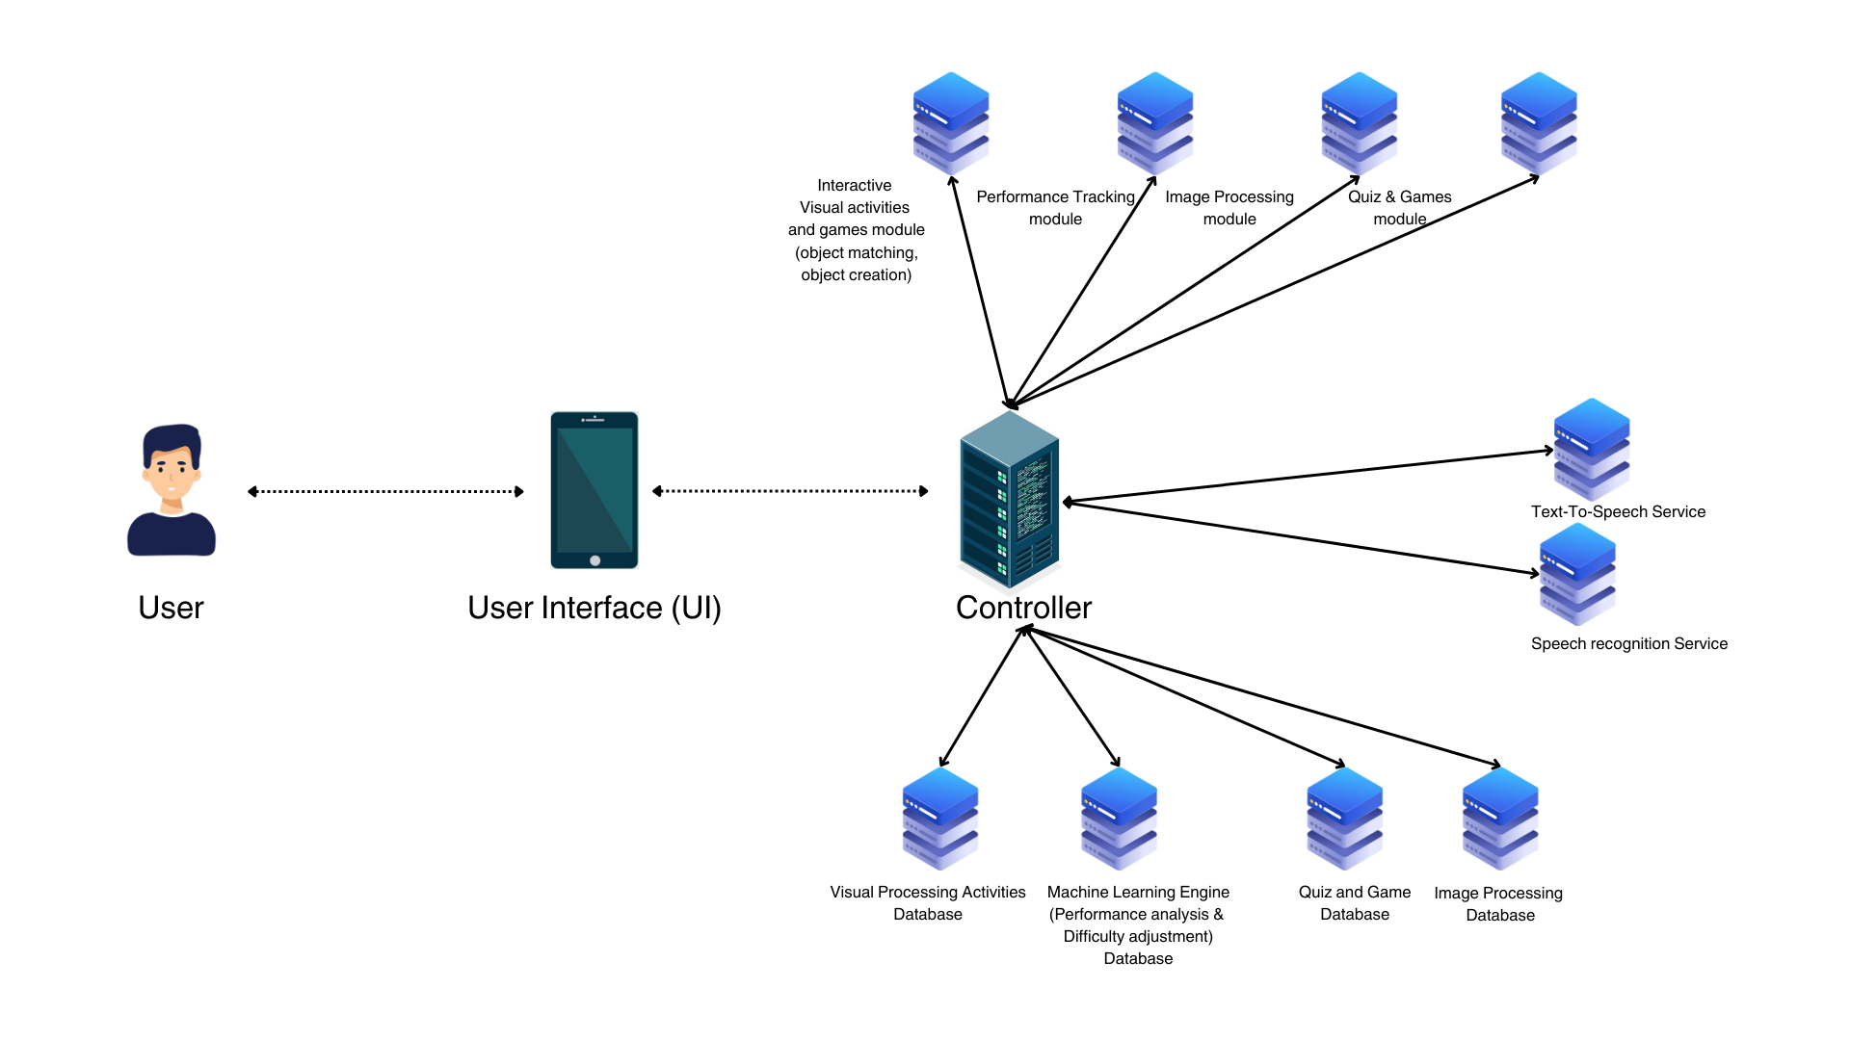
Methodology
System Diagram
IT21273858 | Shangeeth.V | 24-25J-133

Slide 13



Tools & Technologies
Technologies
Machine learning, Image Processing
Languages
Python, Flutter
Storage
MongoDB (pymongo)
IT21273858 | Shangeeth.V | 24-25J-133

Slide 14
Requirements
Functional
Visual Identification Activities
Non-Functional
Reliability
Visual Differentiation of objects
Dynamic Difficulty Adjustment
Accessibility
Engagement
IT21273858 | Shangeeth.V | 24-25J-133

Slide 15
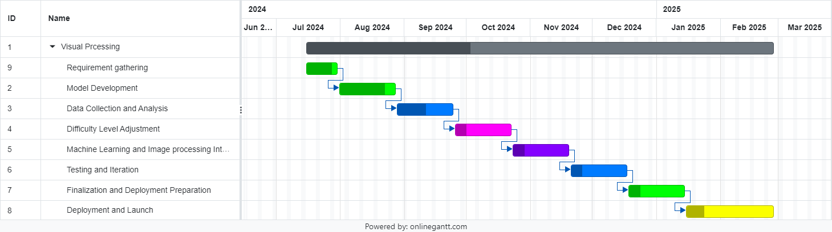
Work Breakdown Structure
Gannt Chart
IT21273858 | Shangeeth.V | 24-25J-133

Slide 16
References
[1] Alba Cotarelo and Jose Manuel Redondo, "Applying color recognition techniques to achieve low-cost portable digital board functionalities," Springer Link, vol. 81, p. 8995–9012, 09 02 2022.
[2] J. Parnell, "Friedship Circle," 28 07 2017. [Online]. Available: https://www.friendshipcircle.org/blog/2017/07/28/4-reasons-to-use-apps-for-kids-with-special-needs. [Accessed 12 06 2024].
[3] Kulkatechol Kanokngamwitroj and Chetneti Srisa-An, "Personalized Learning Management System," TEM, vol. 11, no. 4, pp. 1626 -1633, 11 2022.
[4] Himanshu Shekhar, Sujoy Seal, Saket Kedia and Amartya Guha , "Survey on Applications of Machine Learning in the Field of Computer Vision," in Springer, Singapor, 2019.
[5] Piers Cornelissen, Alex Richardson, Alexandra Mason, Sue Fowler and John Stein, "Contrast sensitivity and coherent motion detection measured at photopic luminance levels in dyslexics and controls," Elsevier, vol. 35, no. 10, pp. 1483-1494, 05 1995.
IT21273858 | Shangeeth.V | 24-25J-133

Slide 17
It21334542|Sanjeeva
SOFTWARE ENGINEERING
IT21334542 | Sanjeeva.N | 24-25J-133

Slide 18

Component 01
Reading Skills Enhancement Module
IT21273858 | Shangeeth.V | 24-25J-133

Slide 19

Introduction
Background
Dyslexia is a common learning disorder affecting 15-20% of the population, making it challenging for individuals to read, write, and spell.
Children with dyslexia often struggle with phonemic awareness, phonics, fluency, and comprehension, which are essential reading skills.
Traditional teaching methods that focus on rote memorization and repetition can be ineffective for children with dyslexia.
Research-based approaches that incorporate multisensory instruction, technology, and individualized learning have shown promise in improving reading outcomes for children with dyslexia.
IT21334542 | Sanjeeva.N | 24-25J-133

Slide 20

Reading Component
Phenomics awareness
sounds the word made up of
Phonic
Letters / arrangement of the letter, that produces certain sound
Key , Ki can make the same sound.
Fluency
Rate of effort to read a word
IT21334542 | Sanjeeva.N | 24-25J-133

Slide 21
Research Problem
How can interactive learning modules, combined with natural language processing (NLP) techniques, be effectively utilized to enhance the reading skills of children with dyslexia?
IT21334542 | Sanjeeva.N | 24-25J-133

Slide 22

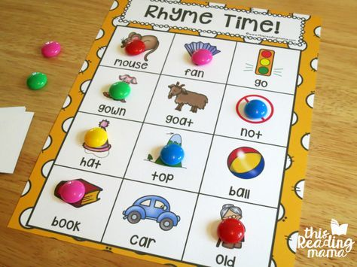

Traditional Enhancement Approaches
Salt Tray
Rhyme Games
Repeated Read

Slide 23
Gaps Identified and Novelties
App existing that serves only targeted scope in Reading Skills
App serves the entire solution and help to reach the ultimate goal of reading - Comprehension
Personalized learning
Usage of ML and NLP helps to provide us a personalized user experience (Tracking, real time feedbacks)
ML for make prediction in on-boarding identification of user Phonic level &
Identify Learning pattern to recommend adjust the difficulty level for progress.
Missing integration of proven techniques
Incorporating proven techniques like Repeated reading, salt tray in a modern aspect
Early intervention focus

Slide 24
Specific and Sub Objectives
Main Objective:
To design and develop a Reading Skills Enhancement Module that improves the reading abilities of children with dyslexia.
Sub-Objectives:
Phonological Awareness
Decoding and Fluency
Reading Comprehension
Reading Difficulties Reduction
Engagement and Motivation
IT21334542 | Sanjeeva.N | 24-25J-133

Slide 25
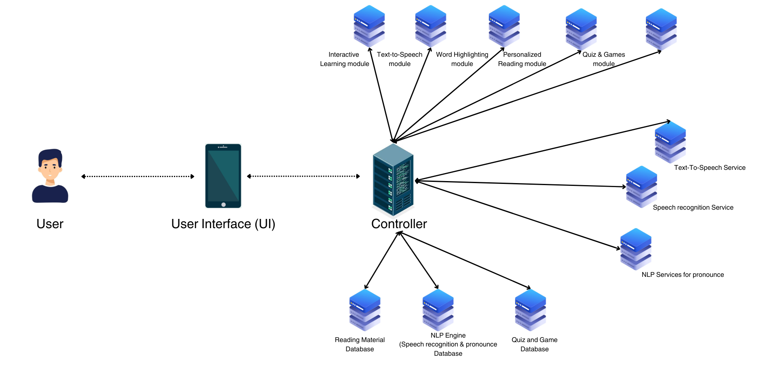
Methodology
System Diagram
IT21334542 | Sanjeeva.N | 24-25J-133

Slide 26
Tools & Technologies
Technologies
Natural Language Processing (NLP), Machine Learning
Languages
Python, Flutter
Storage
MongoDB (pymongo)
IT21334542 | Sanjeeva.N | 24-25J-133

Slide 27
Requirements
Functional
Interactive Learning Modules
Non-Functional
Performance
Text-to-Speech and Word Highlighting
Personalized Reading Materials
Scalability
Usability
IT21334542 | Sanjeeva.N | 24-25J-133

Slide 28
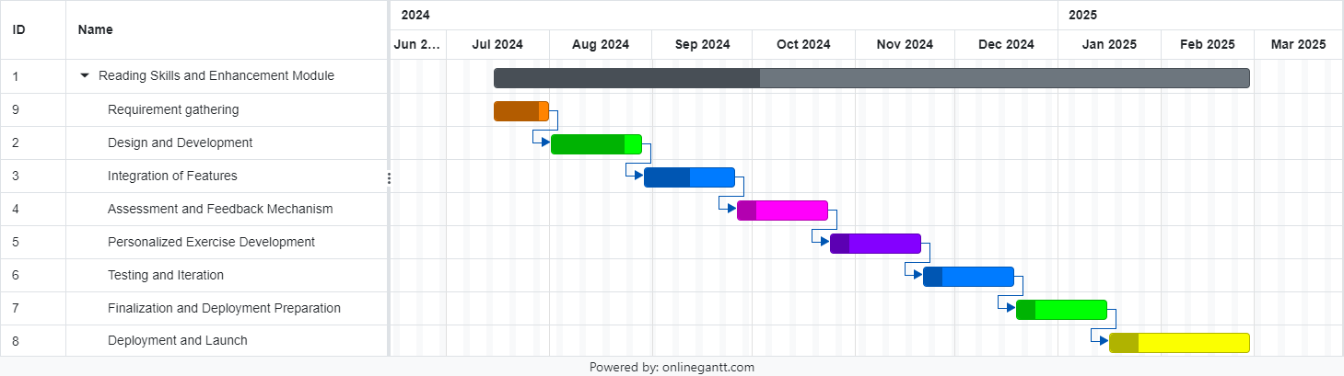
Work Breakdown Structure
Gannt Chart
IT21334542 | Sanjeeva.N | 24-25J-133

Slide 29
References
[1] machinelearningforkids, "machinelearningforkids," [Online]. Available: https://machinelearningforkids.co.uk/. [Accessed 12 06 2024].
[2] Ken Koedinger, Shivang (Shiv) Gupta, Danielle Thomas, Erin Gatz and Bill Guo, "Personalized Learning Squared (PLUS)," PLUS, 2022. [Online]. Available: https://hcii.cmu.edu/project/personalized-learning-squared-plus. [Accessed 15 06 2024].
[3] Ceren Korkmaz and Ana-Paula Correia, "A review of research on machine learning in educational technology," Research Gate, vol. 56, no. 6, pp. 1-18, 11 2019.
[4] Robert Y. Lee, Erin K. Kross, Janaki Torrence, Kevin S. Li, James Sibley, Trevor Cohen, William B. Lober, Ruth A. Engelberg and J. Randall Curtis, "Assessment of Natural Language Processing of Electronic Health Records to Measure Goals-of-Care Discussions as a Clinical Trial Outcome," JAMA Netw Open, vol. 6, no. 3, 02 03 2023.
[5] Thomas Nordström, Staffan Nilsson, Stefan Gustafson and Idor Svensson, "Assistive technology applications for students with reading difficulties: special education teachers' experiences and perceptions," Pub Med, vol. 14, no. 08, pp. 798-808, 11 2019.
IT21334542 | Sanjeeva.N | 24-25J-133

Slide 30
It21176210|Thiraviyarasa.A
SOFTWARE ENGINEERING
IT21 | Thiraviyarasa.A | 24-25J-133

Slide 31

Component 03
Short-term Memory Enhancement Module
IT21176210 | Thiraviyarasa.A | 24-25J-133

Slide 32

Introduction
Background
Short-term memory plays a crucial role in learning and academic achievement, yet many individuals struggle with retaining information in their working memory.
Research has shown that short-term memory deficits can significantly impact academic performance, particularly in subjects like mathematics and reading.
Current interventions often focus on compensatory strategies, but there is a need for a more comprehensive approach that targets the underlying cognitive processes.
The Short-term Memory Enhancement Module is designed to address this need by providing personalized training and exercises to improve short-term memory capacity.
IT21176210 | Thiraviyarasa.A | 24-25J-133

Slide 33
Research problem
How can machine learning techniques be employed to develop adaptive memory training exercises that effectively enhance the short-term memory of children with dyslexia?
IT21176210 | Thiraviyarasa.A | 24-25J-133

Slide 34
Specific and Sub Objectives
Main Objective:
To design and develop a Short-term Memory Enhancement Module that improves the short-term memory skills of children with dyslexia.
Sub-Objectives:
Enhance Short-term Memory
Improve Working Memory
Increase Memory Capacity
IT21176210 | Thiraviyarasa.A | 24-25J-133

Slide 35
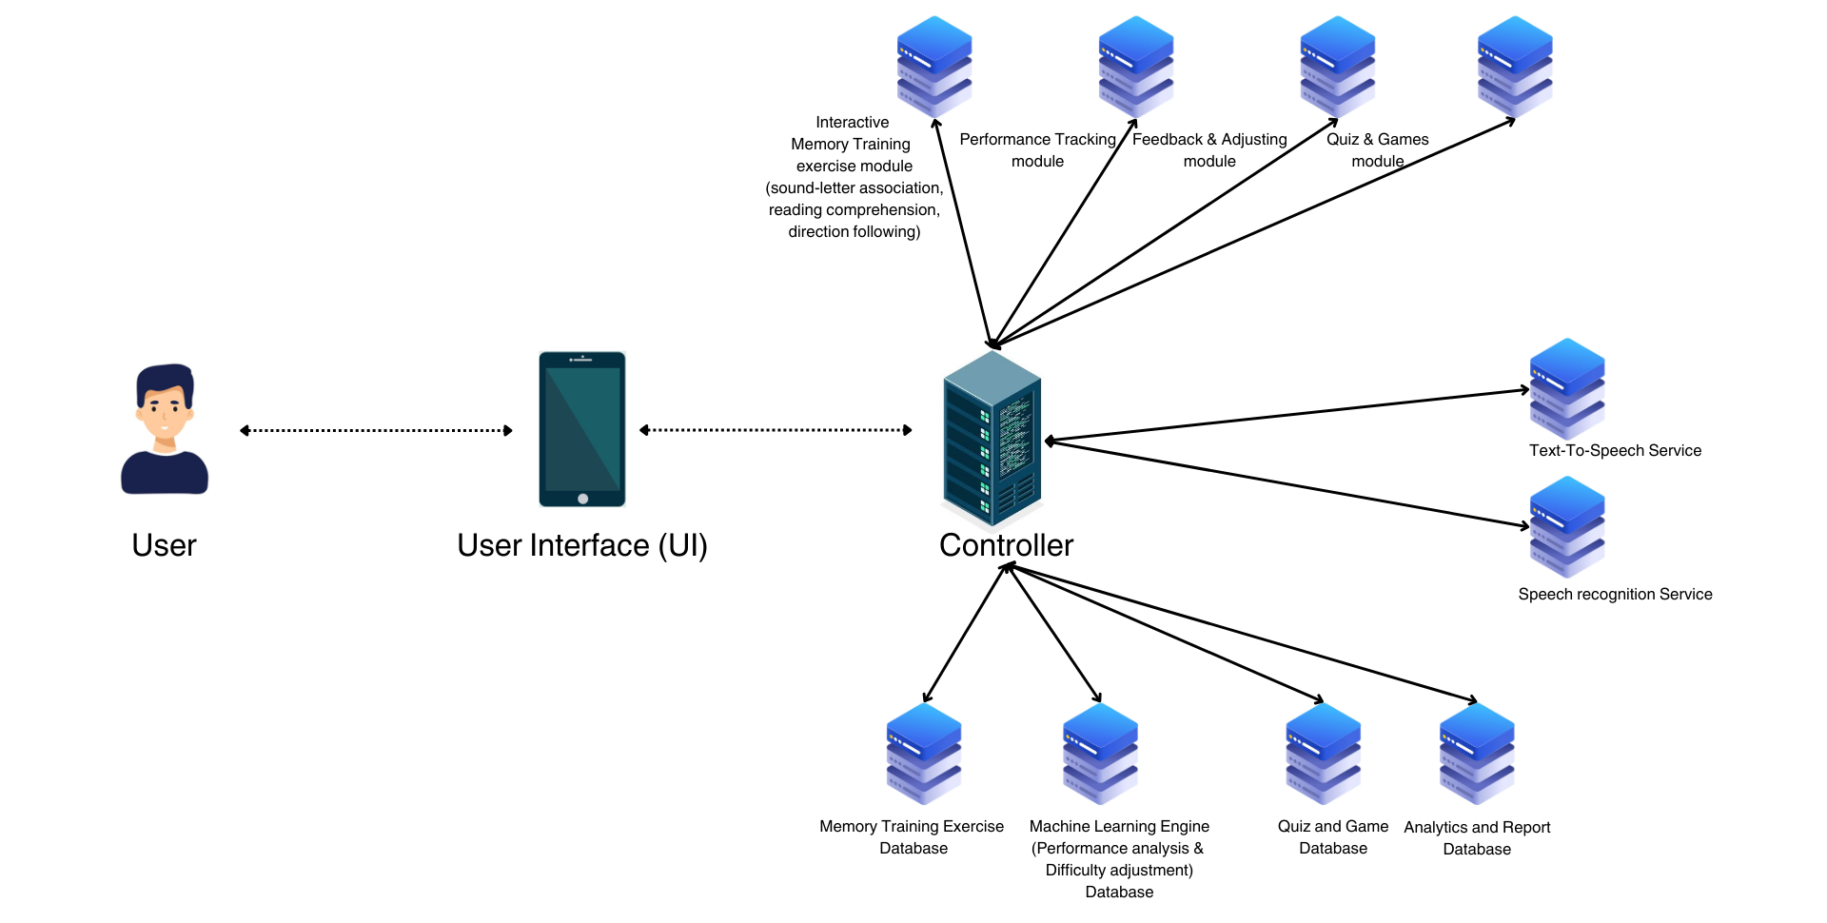
Methodology
System Diagram
IT21176210 | Thiraviyarasa.A | 24-25J-133

Slide 36
Tools & Technologies
Technologies
Machine learning
Languages
Python, Flutter
Storage
MongoDB (pymongo)
IT21176210 | Thiraviyarasa.A | 24-25J-133

Slide 37
Requirements
Functional
Memory Training Exercises
Performance Data Analysis
Personalized Memory Exercises
Non-Functional
Efficiency
Security
Adaptability
IT21176210 | Thiraviyarasa.A | 24-25J-133

Slide 38
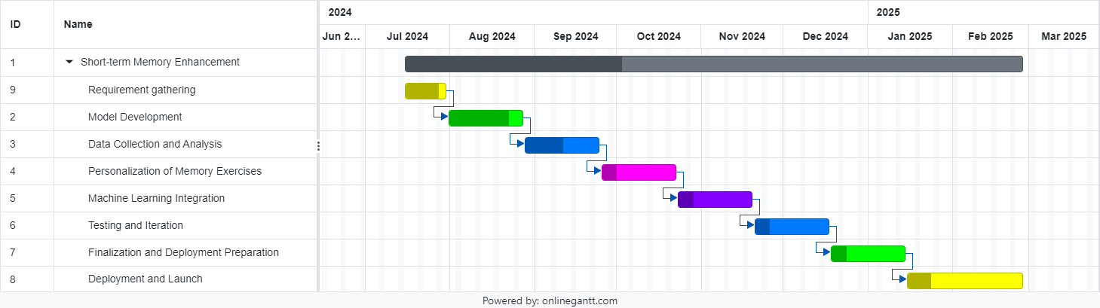
Work Breakdown Structure
Gannt Chart
IT21176210 | Thiraviyarasa.A | 24-25J-133

Slide 39
References
[1] Thomas S. Redick, Zach Shipstead, Elizabeth A. Wiemers, Monica Melby-Lervåg and Charles Hulme , "What’s Working in Working Memory Training? An Educational Perspective," Springer Link, vol. 27, p. 617–633, 02 06 2015.
[2] Blanka Klimova and Martin Valis, "Smartphone Applications Can Serve as Effective Cognitive Training Tools in Healthy Aging," PMC, pp. 9-436, 04 01 2018.
[3] Reut Shani, Shachaf Tal, Sigal Zilcha-Mano and Hadas Okon-Singer, "Can Machine Learning Approaches Lead Toward Personalized Cognitive Training?," PMC, pp. 13-64, 04 04 2019.
[4] Kanyin Feng, Xiao Zhao, Jing Liu, Ying Cai, Zhifang Ye, Chuansheng Chen and Gui Xue, "Spaced Learning Enhances Episodic Memory by Increasing Neural Pattern Similarity Across Repetitions," PMC, vol. 39, no. 27, p. 5351–5360, 03 07 2019.
[5] Gabriela Feitosa Esplendori, Rika Miyahara Kobayashi and Vilanice Alves de Araújo Püschel , "Multisensory integration approach, cognitive domains, meaningful learning: reflections for undergraduate nursing education," PMC, vol. 56, 11 04 2022.
IT21176210 | Thiraviyarasa.A | 24-25J-133

Slide 40

Q&A

Slide 41

THANK YOU

